Slide 1
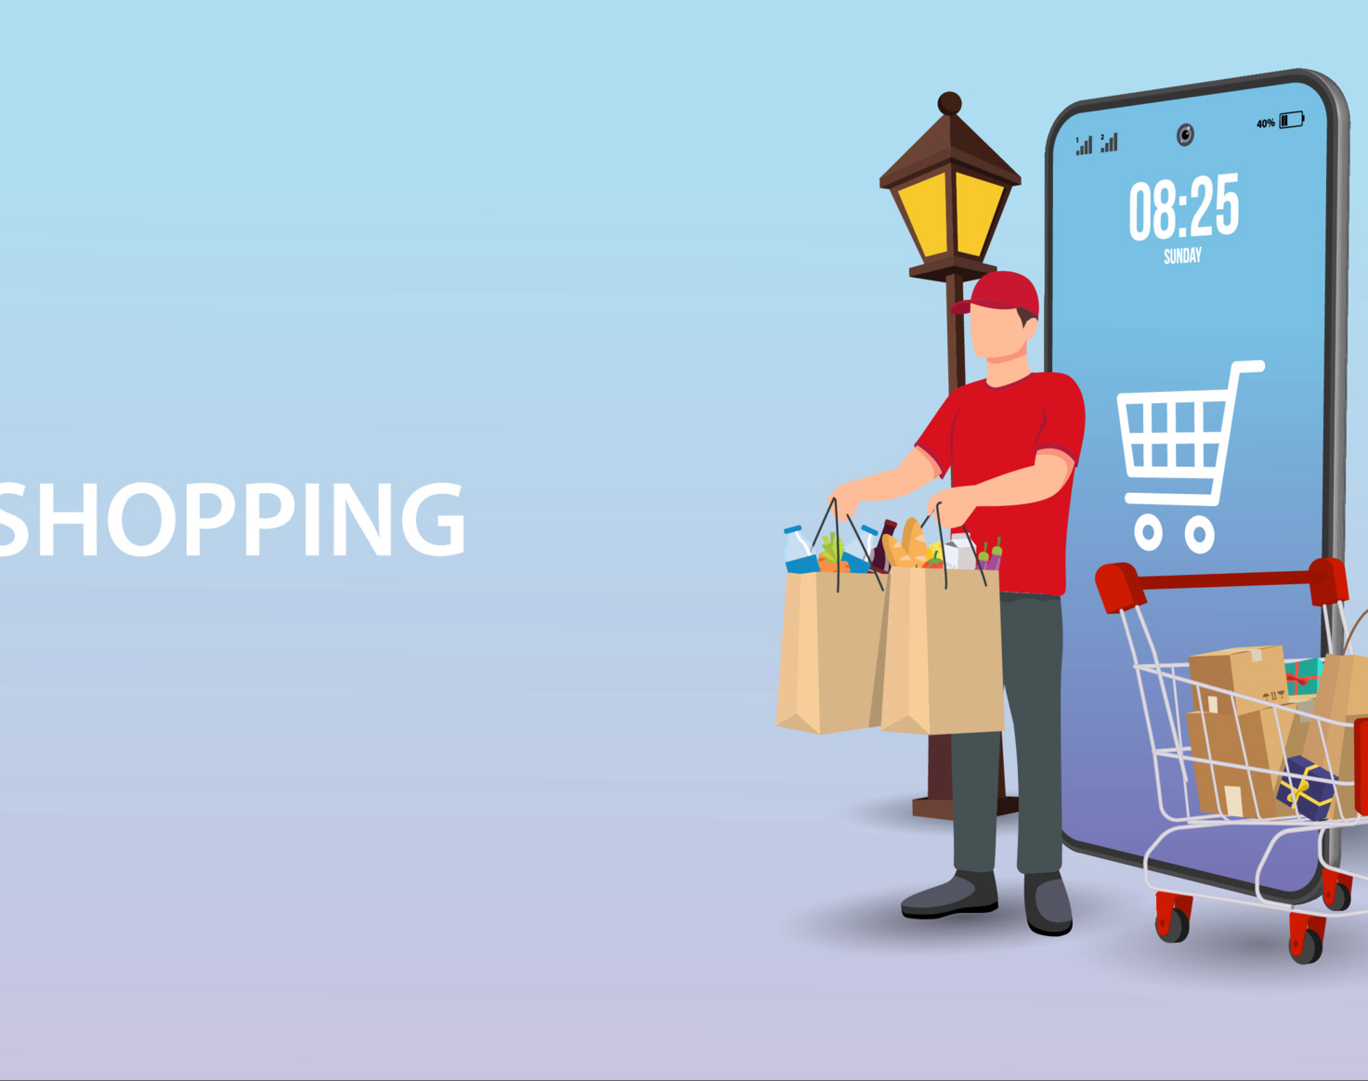

FRESH HARVEST
Delivering Freshness at your Doorstep
Team Members
Rajat Sharma – 002736944
2. Yash Pawar – 002747371
3. Nupoor Korde – 002792237
4. Chakradhar Grandi Durga - 002933727

Slide 2

Problem Statement
Traditional grocery shopping can be time-consuming and inconvenient for customers.
Our portal provides user-friendly interface, a diverse product range and reliable delivery options, to cater to the needs of customers and provide a convenient and hassle-free shopping experience.

Slide 3




Tech Stack We Used
Tech Stack Used.
ReactJS, Express, Mongo, NodeJS (MERN Stack)

Slide 4

External APIs Resources Used
EmailJS: To send verification email
Paypal: For payment gateway integrate
Bcrypt: To safely store user Password in Database

Slide 5
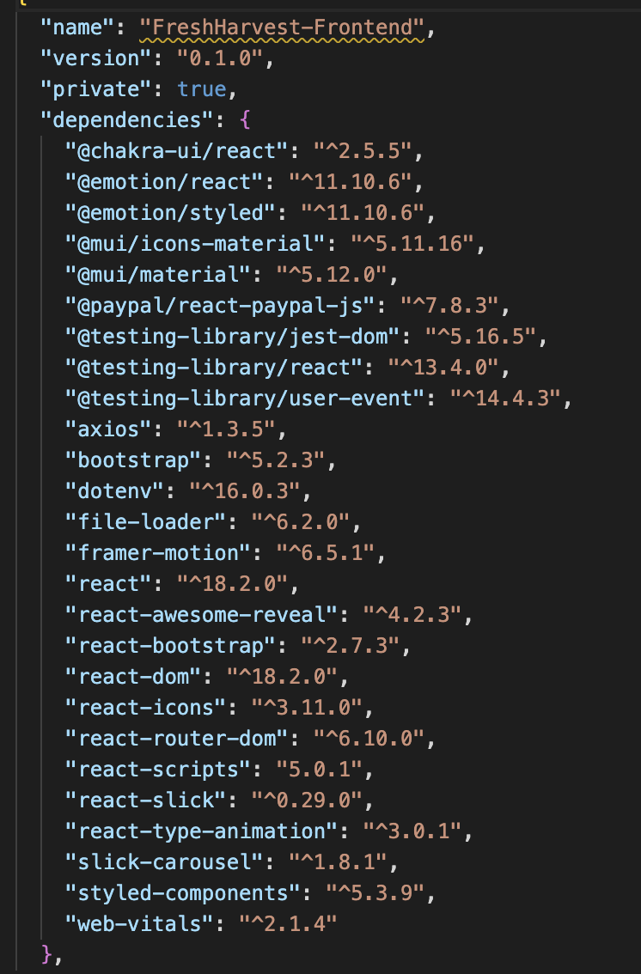
Libraries Used

Slide 6
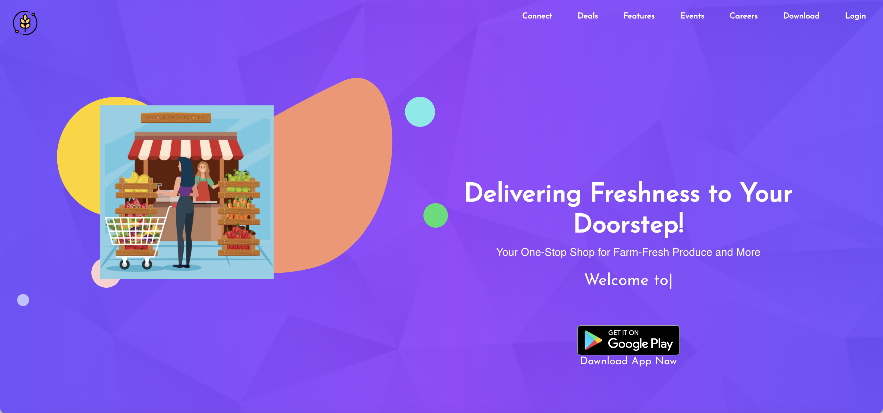
Landing Page

Slide 7
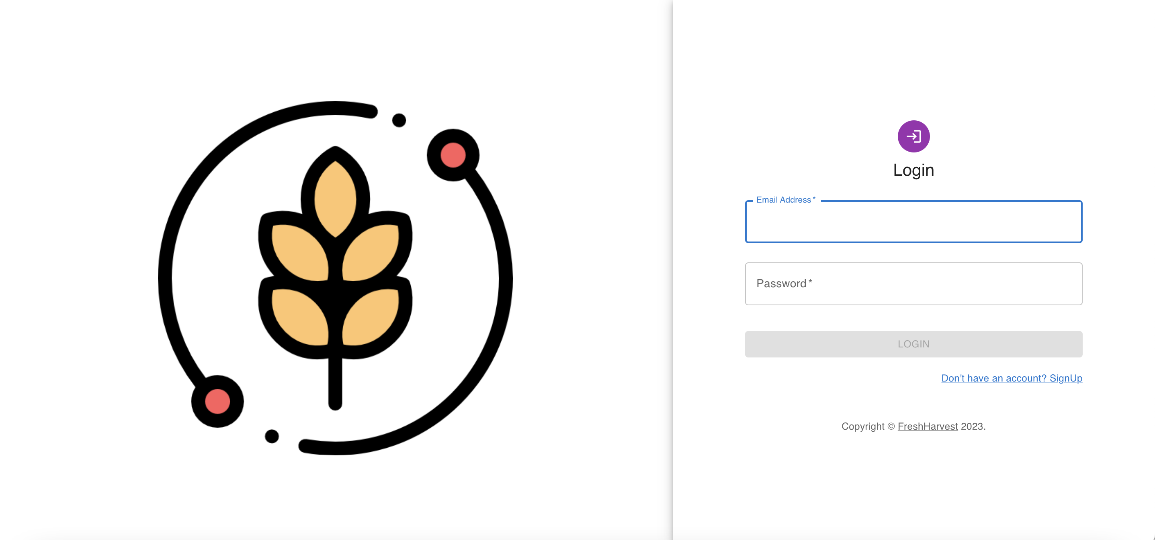
Login Page

Slide 8
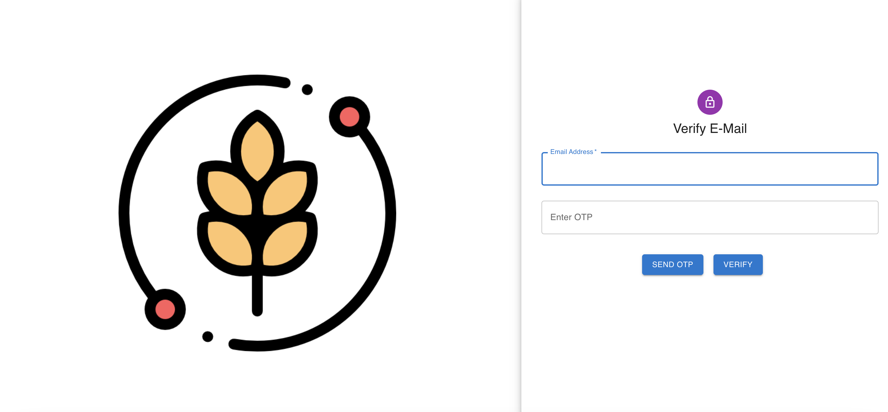
Verify E-Mail

Slide 9
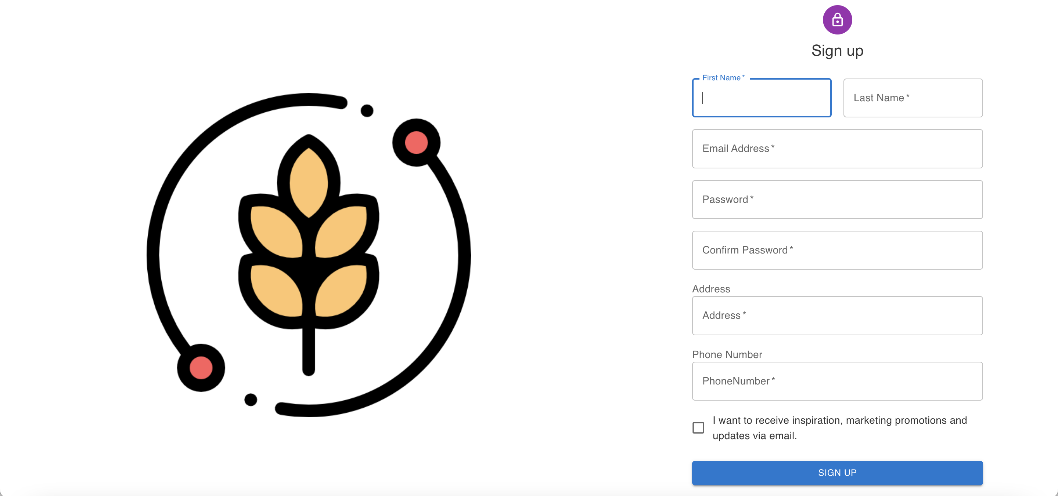
Sign Up Page

Slide 10
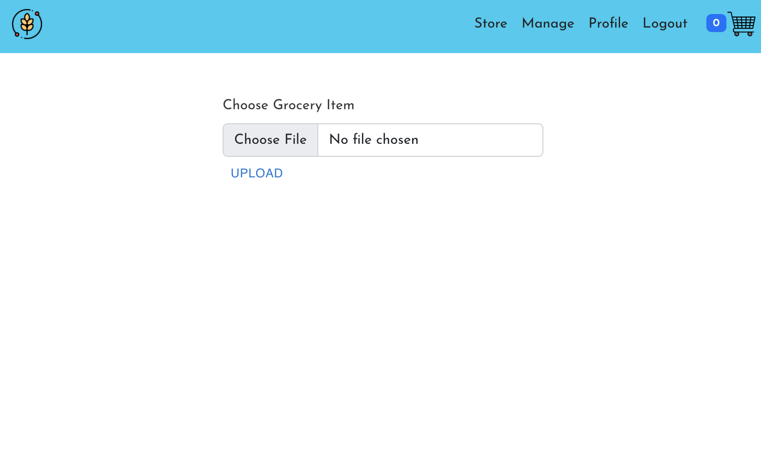
Admin Page -Manage Grocery Items

Slide 11
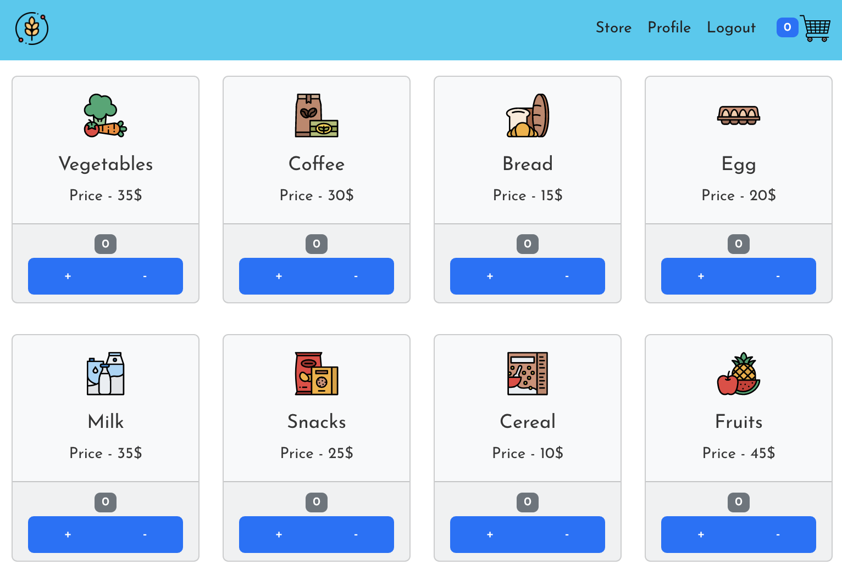
Grocery Store

Slide 12
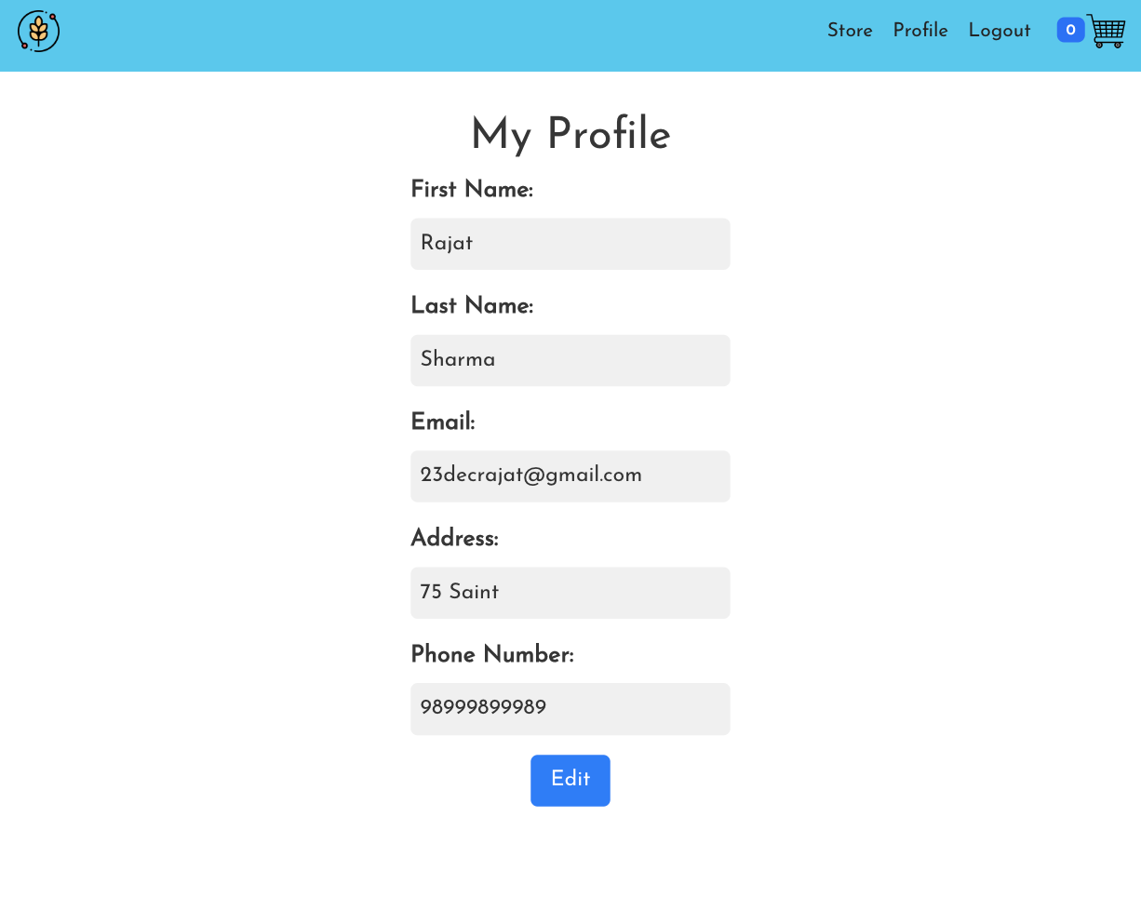
Update User Profile

Slide 13
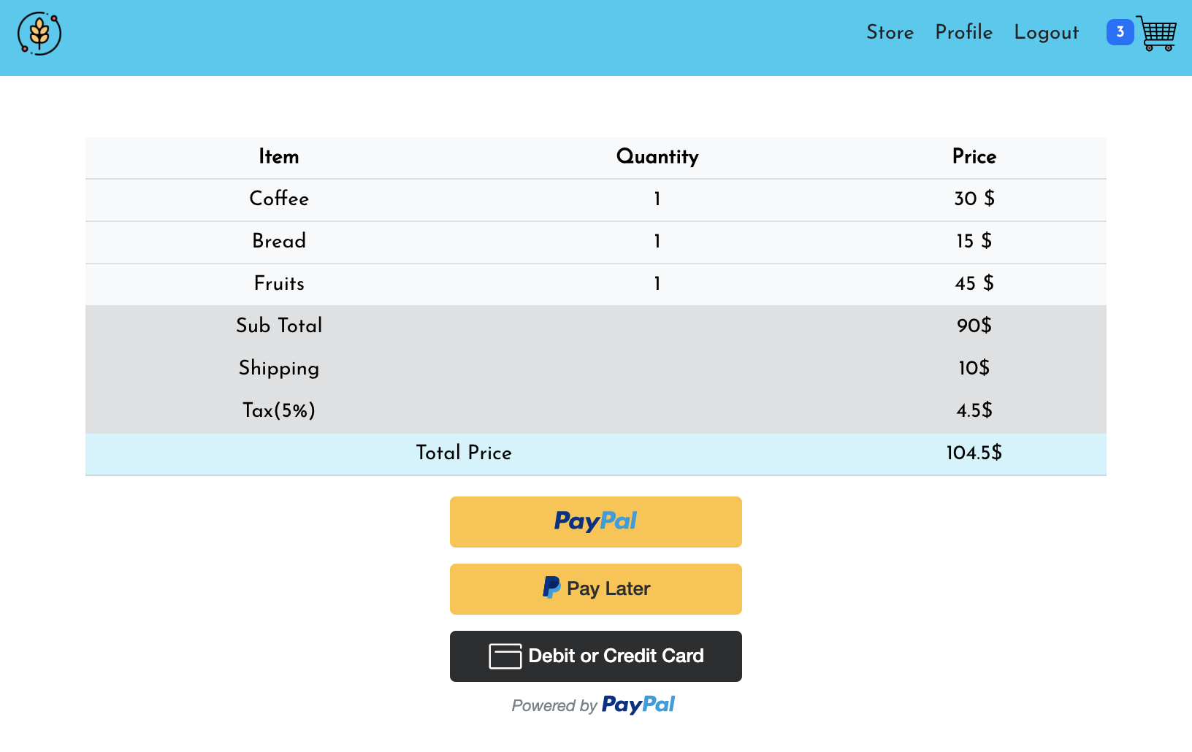
Cart Items

Slide 14
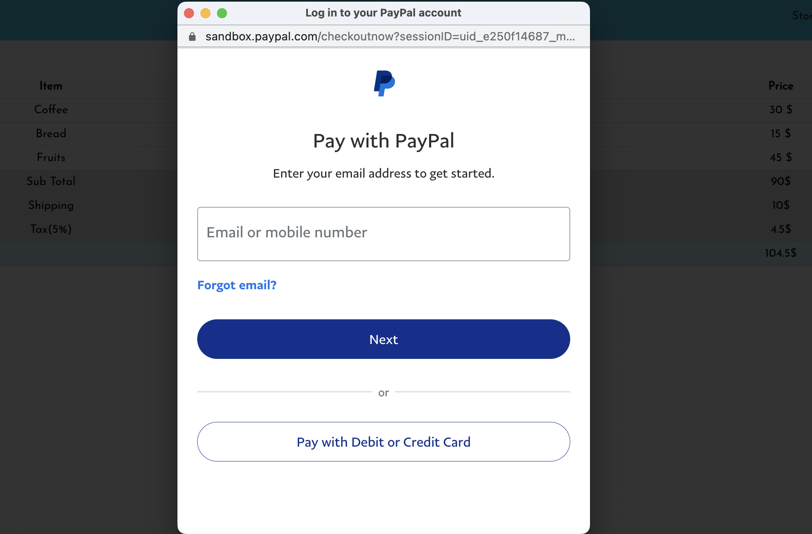
Payment Methods - Paypal - Pay Later - Credit/Debit card

Slide 15
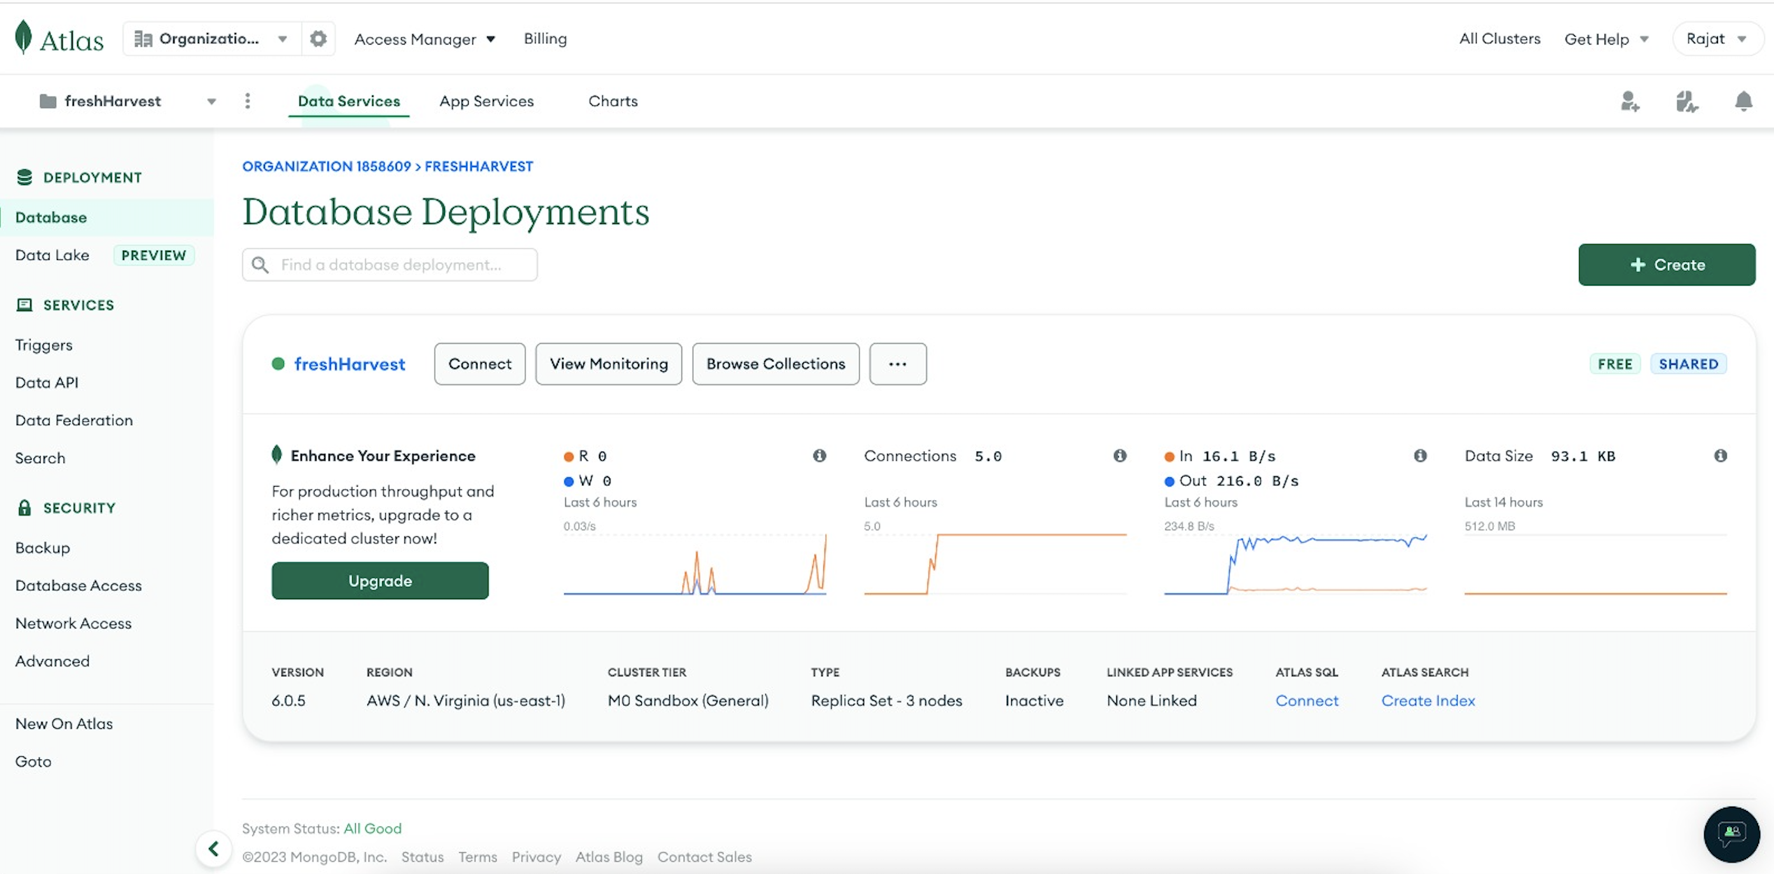
Database Deployment Cloud Atlas

Slide 16
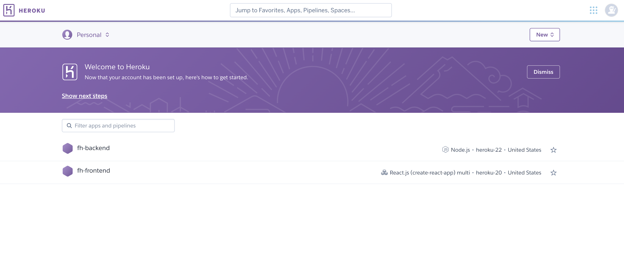
Application Deployment Heroku - Backend - Frontend

Slide 17

Thank You
Questions?

